Slide 1


The Competitiveness Pole of Sousse
“National Stakeholders Workshop”,
09/12/2014 AFRICA Hotel
Notes:
Good afternoon, ladies and gentlemen! I’m very pleased to be with you today. For the next 20 minutes it will be a pleasure for me to present our company that is called the Competitiveness Pole of Sousse. If you have any questions, I will be glad to answer them at the end of my presentation.

Slide 2


IME Sectors in Tunisia
1000 Companies
130 000 Jobs
1st Export sector in Tunisia
31% Tunisian Exports
A growth over of 16% per year
Notes:
To point out the importance of this sector not only for Sousse but for the whole country, I will give you a short overview of the IME sector in Tunisia:
The IME sector includes 1000 companies, offers 130 000 jobs and represents the most important export activities in the country. It disposes about 31% of the industrial exports and it evolves a growth of over 16% per year.

Slide 3
The Pole of Sousse
Privately held company
Founded in early March 2009
Public-Private-Partnership created for developing the economical and social sectors dedicated to the Mechanical, Electronic and Data Processing Industry (IME sectors).
Notes:
So let me introduce our company:
The Pole of Sousse is a privately held company, founded in early March 2009.
It is a Public-Private-Partnership created for developing the economical and social sectors of the Mechanical, Electronic and Data Processing industry, also called IME sector.

Slide 4
The Pole of Sousse - Strategic objectives (1/2)
Bridging the Gap between:
  Training
  Research
  Production
Promoting the entrepreneurship and the incubation of innovative companies, by disseminating research activities
Improving the ability of the industry’s competitiveness
Encouraging the Direct Foreign Investment in Tunisia
Notes:
In this context, the Technological Pole of Sousse is getting involved in the issue of developing the sector and supporting companies working in this sector. The aim of the Pole is to achieve the following strategic objectives:
At first, the Pole is bridging the Gap between Training, Research and Production.
Then, the Pole promotes the entrepreneurship and the incubation of innovative companies by supporting research activities
The Pole is also improving the ability of the industry’s competitiveness
Finally it is encouraging the direct foreign investment in Tunisia

Slide 5
The Pole of Sousse - Strategic objectives (2/2)
Higher Education
Industrials
POLE OF SOUSSE
Research & Innovation
Support structures
Notes:
The Technological Pole of Sousse includes the following zones:
The Technological Pole itself (55 Ha)
The off-shoring area of Hammam Maarouf (48Ha)
The industrial support area at Enfidha (142Ha)
Moreover, the Network between these zones is a very important point.
In addition, the pole is intended to bring together the activities of higher education, research and innovation and industrial services as well as giving business support to interested companies.

Slide 6
Components
The pole of Sousse includes :
  Technopark (55ha)
  Off-Shoring Park of Hammam Maarouf (48ha)
  Industrial Park of Enfidha (142ha)

Slide 7
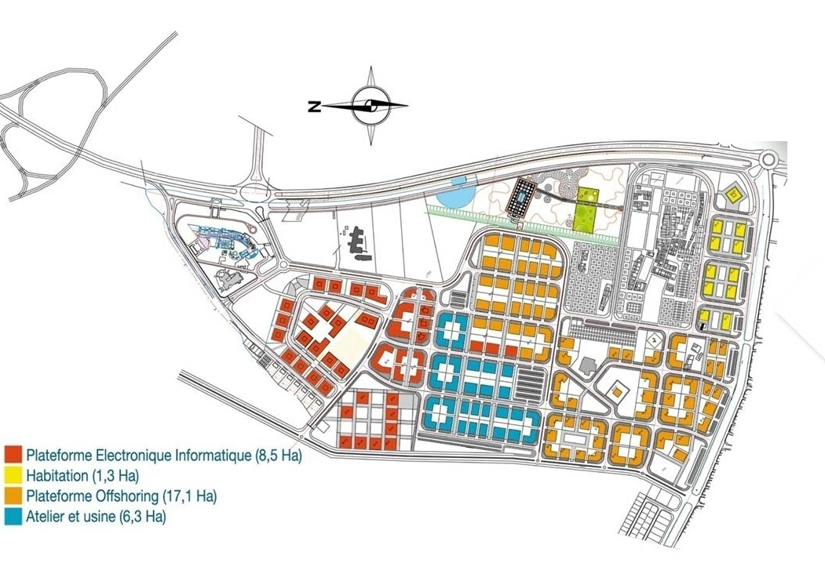
The Technopark& the Off-Shoring park of Hammam Maarouf
Technopark
55 hectares
Business incubator
National Engineering School of Sousse
Research Center
Technology Resource Center
Industrial Spaces
Off-Shoring Area
48 hectares
Notes:
To explain the different zones of the Technological Pole, I’d like to give you some more information concerning the Technopark first, which is an integrated space over surface of approximately 55 hectares, including :
A Business incubator
A National Ingineering Shool of Sousse
A Research Center
A Technology Resource Center
And an Industrial Spaces
The second zone, the off-shoring area, has 48 hectares of surface.
The third zone is the industrial zone of Enfidha which contains 142 hectares.

Slide 8
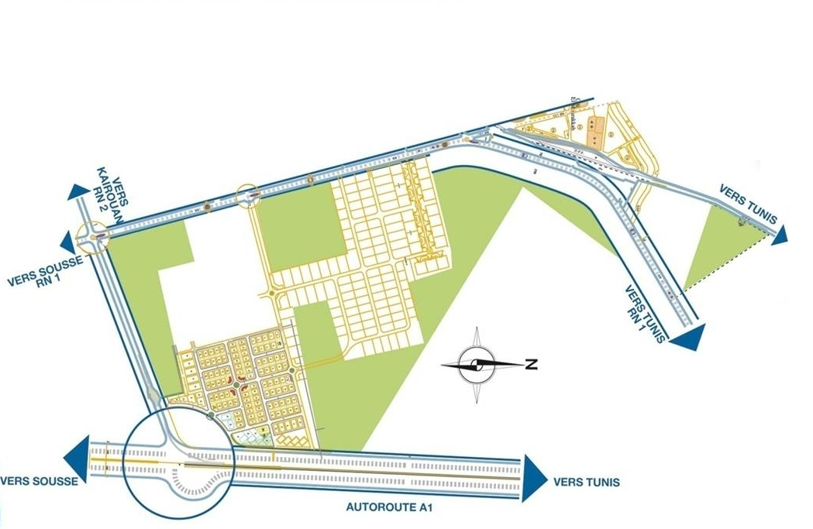
I.Z of ENFIDHA
I. Z of Enfidha
142 ha (Mullti Zone).
30 minutes from the technopoark.
in front of the international airport of Enfidha.
35 km from the commercial port of Sousse.

Slide 9
INFRASTRUCTURES
All the zones will be developed according to the best European building standards
      Fibers optic for fast and efficient communication
      Water-treatment sewage plant
      Water pipe, gas pipe, electrical connection
      Public lighting , parking, sidewalks, parks

Slide 10
The Technopark& the Off-Shoring park of Hammam Maarouf
Area (Ha) | Technological Pole | Off-Shoring Area | Total
Higher Education & Scientific Research (ha) | 20 | ____ | 20
SPCS (ha) | 35 | 48 | 83
City Parc (ha) | ____ | 10 | 10
Private / Housing (ha) |  | 11 | 11
Total | 55 | 69 | 124
Number of Industrial Firms | 92 | 65 | 157
Number of Relay Workshops | 14 | ____ | 14
Number of job to be created | 22.000 | 23.000 | 25.000
Covered Industrial Areas (m²) | 97.000 | ____ | 97.000
IME & off-Shoring Areas (m²) | 200.000 | 350.000 | 550.000
The pole of Sousse includes :
  Technopark (55ha)
  Off-Shoring Park of Hammam Maarouf (48ha)
  Industrial Park of Enfidha (142ha)
Notes:
Let’s have a look at some figures about the Technological Pole and the off-shoring area of Hammam Maarouf :
As you can see, the part reserved for the higher education & scientific research is 20 hectares and for SPCS 35 hectares.
The off-shoring area has 48 hectares…

Slide 11
Innovation and Technology Transfer

Slide 12
Innovation & TT
The cell innovation and technology transfer offers services for the company :
modern infrastructure
ecological environment
free access to high qualified intelligence
ease of implementation
recruiting of a skilled workforce
professional animation of the pole
access to founding sources
development of relationships with subcontractors/
other types of partnerships
easy access to local and regional market
Support
Notes:
In addition to a modern infrastructure, an ecological environment and a free access to high qualified intelligence, the Technological Pole provides its customers with:
The ease of implementation,
The recruiting of a skilled workforce,
The professional animation of the pole
The access to funding sources
The development of relationship with subcontractors, and other types of partnerships
The easy access to local and regional market
And, first of all, Technological Pole will be the only referent for the companies in all these procedures; they don’t need to contact various institutions.

Slide 13
Innovation & TT
Current Strucure
Innovation & TT at SPCS
CRNM
Incubator
CIDT
Cluster
CRT
Eniso
BUTT
RE
Business Angels Sahel
CRIC
Notes:
CIDT: Centre d’innovation et de développement Technologique
CRIC: Comité régionale de l’innovation ( Chambre du commerce et de l’industrie du centre)
RE: Réseau entreprendre

Slide 14
Innovation & TT
Strategic Vision
Invention
Assessment
Protection
Marketing
Financial Return
Invention Disclosure
Licensing
Technology
Transfer
Process

Slide 15
Innovation & TT
The area of transfer and technological innovation includes :
Business Incubator
Engineering School
Technology Resource Center
Research Center in Microelectronics and Nanotechnology
Cluster Mechatronic Tunisia

Slide 16
Business Incubator
Support structure that supports new promoters and provides the necessary assistance to the formalization and implementation of their projects.
Surface (2680 m² covered ): 24 production units , 22 offices, meeting rooms etc ...
Current occupancy rate 99%
Hosting 18 companies
3 companies in progress hosting
Employing 240 people including 200 engineers

Slide 17
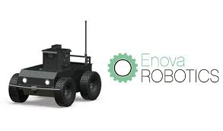
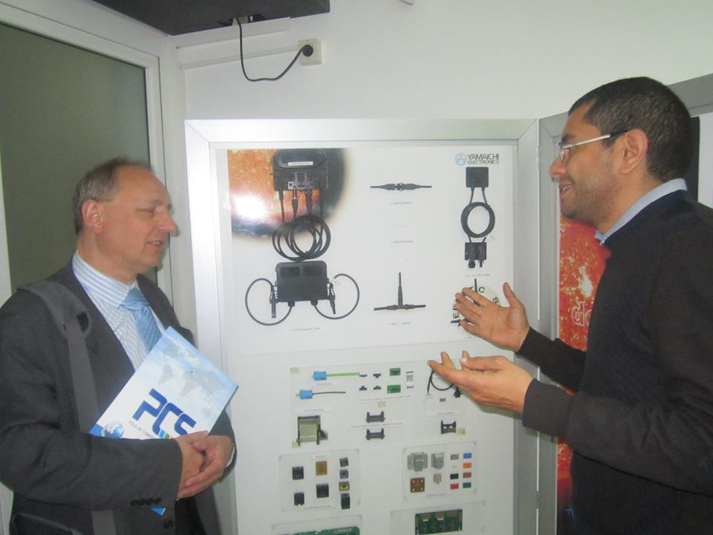
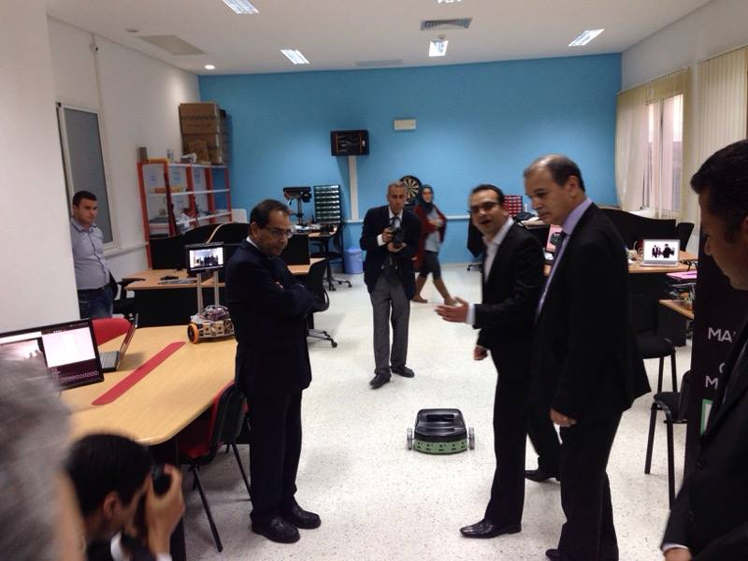

Business Incubator

Slide 18
National Engineering School of Sousse
The National Engineering school of Sousse provides trainig for engineers in :
    Mecatronic
    Applied Informatics
    Industrial Electronics
NISS delivers a professional master’s degree in:
    Ingineering systems automotive safety
    Intelligent communication systems
    Industrial Embedded Systems

Slide 19
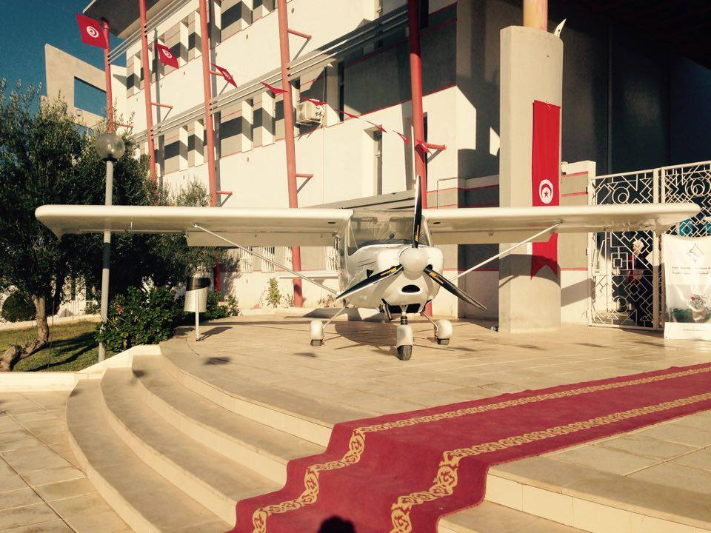
National Engineering School of Sousse
The first Tunisian plane manufactured locally by
«Oxygen aéronautique»

Slide 20
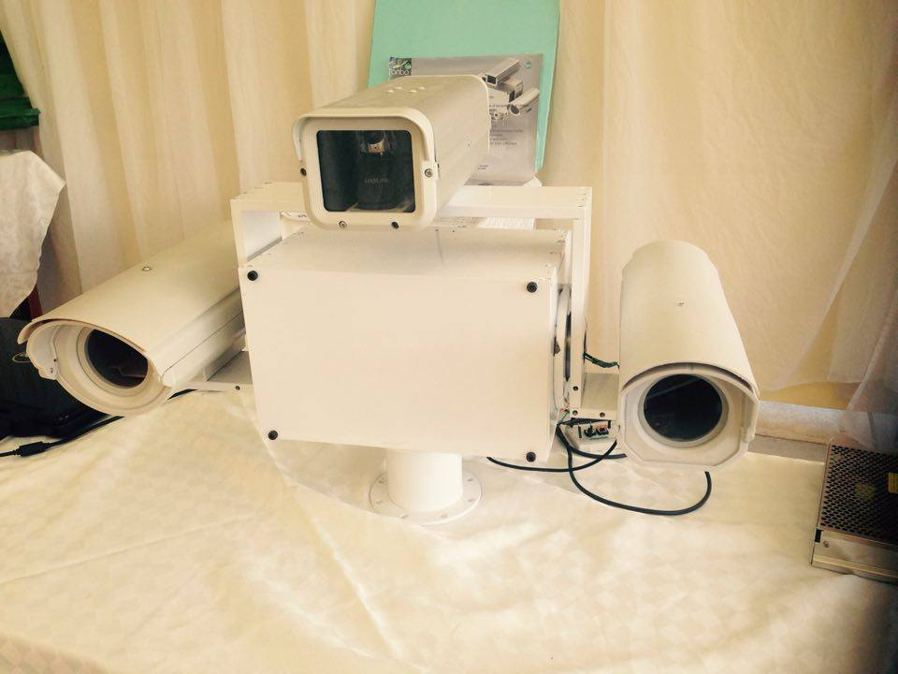
National Engineering School of Sousse
Robotics Pan Tilt Unit : Advanced Mechatronic Systems
Long Range Camera :
determine the distance betewen the turret and the object
Reach tens of tens of kilometers and laser range finders
Notes:
Les Tourelles robotisés : sont des Caméras de très longue portés qui peuvent atteindre des dizaines de kilomètres et des télémètres laser qui servent à déterminer la distance entre la tourelle et l’objet.

Slide 21
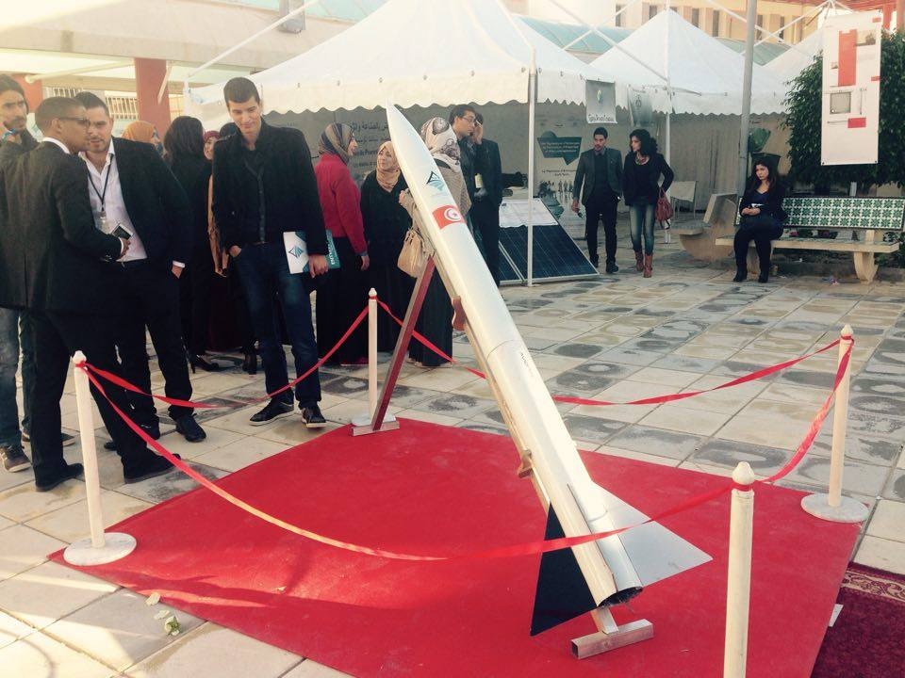
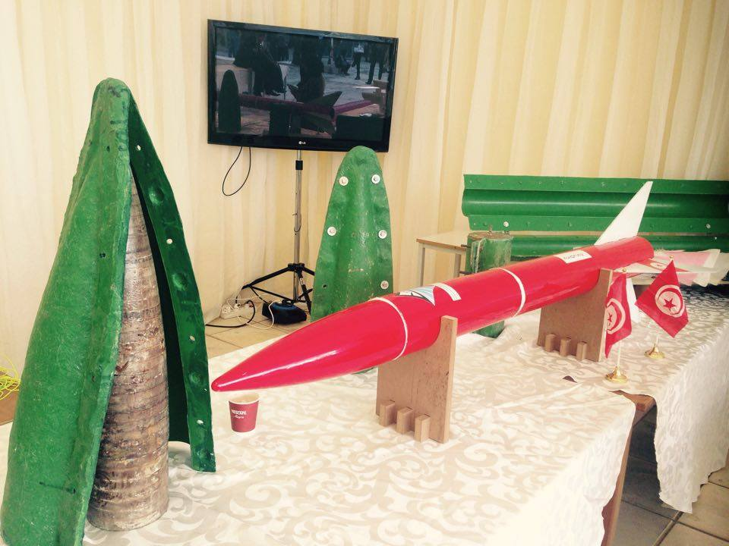
National Engineering School of Sousse
Launch of a rifle : Convergence days ENISo-Entreprises 02/12/2015

Slide 22
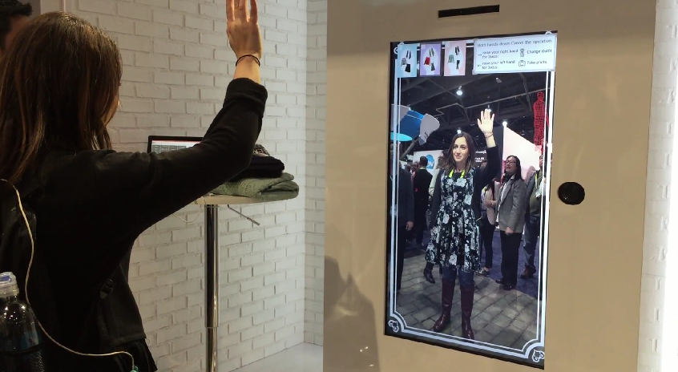
National Engineering School of Sousse
Dressing Room Virtual
A virtual dressing room is the online equivalent of the near-ubiquitous in-store changing room – that is, it enables shoppers to try on clothes to check one or more of size, fit or style, but virtually rather than physically.

Slide 23
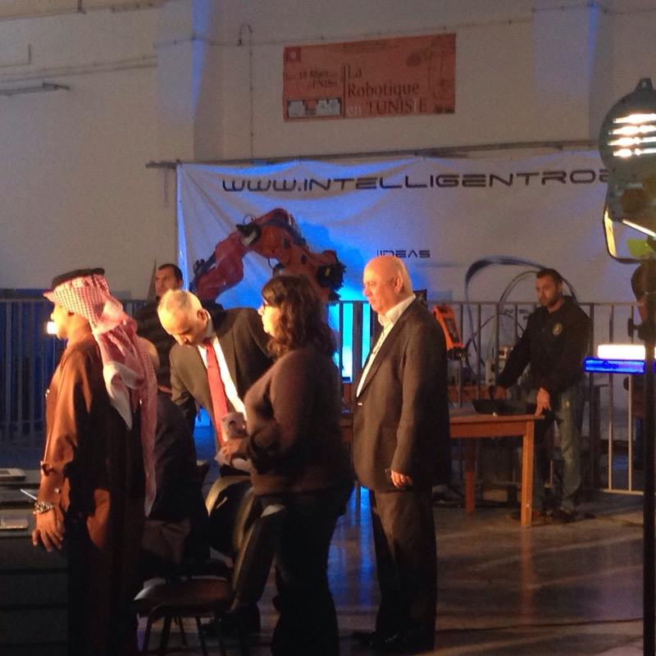
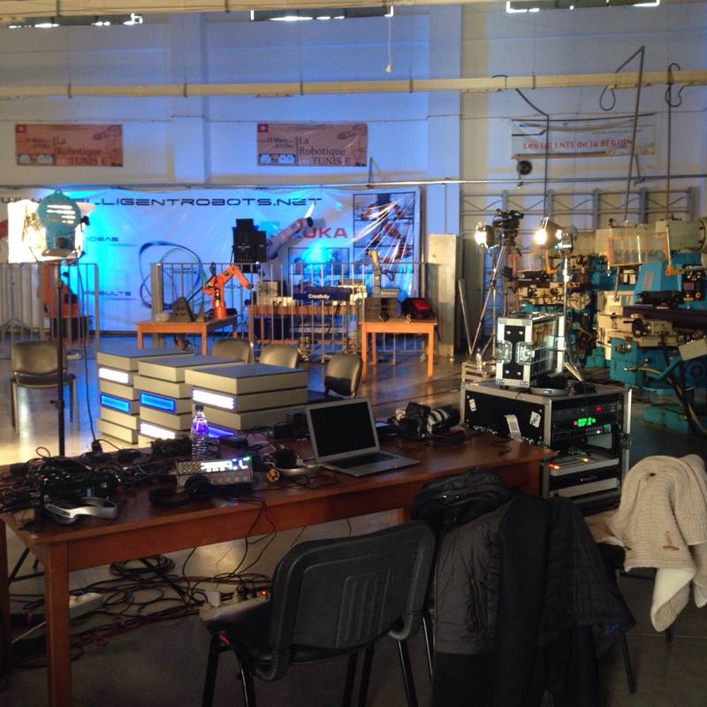
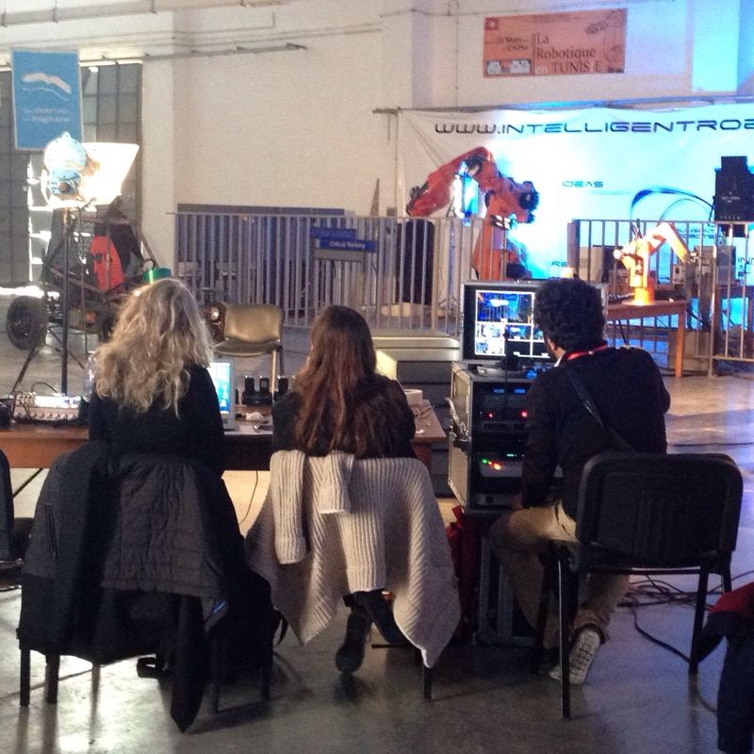

National Engineering School of Sousse
STARS OF SCIENCE
Season 7 / 2015

Slide 24
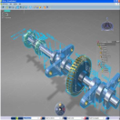
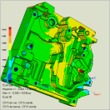
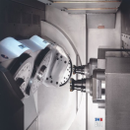
Technology Resource Center
conception
Simulation
Manufacturing
Notes:
The technology resource center supports the following activities:
the conception, the simulation and the manufacturing.

Slide 25
Research Center in Microelectronics and Nanotechnology
a clean room dedicated to various methods
an area of physico-chemical and electrical packaging and technical facilities
Three Laboratories:
Microelectronic Systems Laboratory
Laboratory of advanced materials and nano-physics
Laboratory Microsystems physical, chemical and biological weapons
Notes:
The Research in Microelectronics and Nanotechnology Center concentrates mainly on the following areas:
A Technology Center for Microelectronics, which includes a cleaning room dedicated to various methods, an area of physico-chemical and electrical packaging and technical facilities.
Three Laboratories:
Microelectronic Systems Laboratory
Laboratory of advanced materials and nano-physics
Laboratory Microsystems physical, chemical and biological weapons.

Slide 26


CLUSTER MECHATRONIC
TUNISIA
Legal status: Association Scientific
Creation Date: March 2012
Number of members (2012): 16
Number of members (2015): 50
Employment: 5000
Associate Members: ENISO-CETIME-Research Centre in Nanotechnology and Micro Electronics of Sousse

Slide 27
CLUSTER MECHATRONIC
TUNISIA
Objectives:
➥Mobilizing financial resources and implement collaborative and collective actions in different operational fields such (commercial, innovation, industrial organization, skills, financing) and any other field deemed useful for the development businesses.
➥Taking part in thinking about skills development on the territories and with different structures.
➥Promoting the economic, commercial and technological development of its members through support actions, investment and / or industrial cooperation
.

Slide 28
CLUSTER MECHATRONIC
TUNISIA
Means
In order to implement the objectives, the Cluster Mechatronic Tunisia benefits from:
The Support of the Competitiveness Pôle of Sousse for animation and management.
A Animator on full-time
An International Expert
An AFD financing mobilized by the cluster in Sousse for cluster management and part of the implementation of collaborative actions
Corporate contributions (premiums)
An active and effective governance

Slide 29
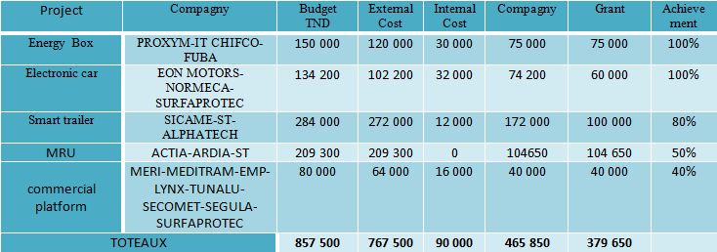
CLUSTER MECHATRONIC
TUNISIA
Projects labelized
Projects
These projects are funded to 50% thanks to AFD funding, they pass through SPCS, and companies pay back5% of grants to constitute a reserve fund that can be assigned to future management.

Slide 30



CLUSTER MECHATRONIC
TUNISIA
Project Sample
A security system within wireless control MRU thread
(Universal Radio Module)
Objectives:
Offer a solution wireless control of dangerous industrial machines
Bring to company ST prove that its range of microcontrollers is certifiable safety
Set up a local organization (Tunisian), that can ensure the development, technological support, qualification, certification and industrialization of complex products.
.

Slide 31



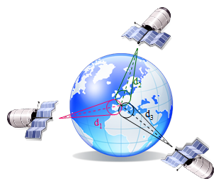
CLUSTER MECHATRONIC
TUNISIA
Project Setting
  This project falls within the scope of Public Private Partnership between the Cluster and the Sahel Transport Company (STS)
Improving Quality of Transport
Objectives:
  Organize resources and skills that exist in the CMT to develop and offer innovative and practical solutions that respondent directly to the need of the (STS) In:
      Energy savings
      Ticketing system (Application mobile website ...)
      Digital network mapping
      Passenger identification system
      Collection System
      Setting up an information system
      Géo localization

Slide 32

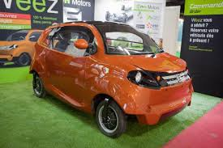
CLUSTER MECHATRONIC
TUNISIA
Projects
INNERJ-BOX
LA WEEZ
LA MRU

Slide 33



CLUSTER MECHATRONIC
TUNISIA
Cluster related research : Smart Home
Objectives:
Developing new products as part of the construction of a Smart Home (MI) based on scalable systems and removable modular building
The house will be equipped with a variety of energy-saving systems, sensors, ecological materials, etc..
The ICT is a fundamental component of the Smart Home

Slide 34
Partnerships with other Poles and international Cluster
France :
    Sophia Antipolis
    Pole de Pégasse
    Pole ViaMéca
    France Clusters
    CAMDIB
Belgique:
    Mecatec
Italie:
    Pole VITA
    Pole MESAP
    Finlande :
    MERINOVA
    Egypte :
    Smart Village

Slide 35
THANKS FOR YOUR ATTENTION
CONTACT
Mr. Hichem Turki
Phone +216 73 36 77 53
Fax +216 73 36 77 54
E mail h.turki@pcs.tn
www.pcs.tn

Slide 36


