Slide 1
Establishing National Technology Development and Transfer Systems
in selected ESCWA member States
United Nations Development Account
UN ESCWA Technology Centre
Amman-Jordan

Slide 2

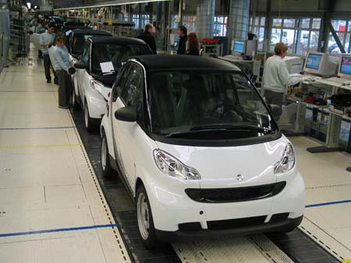

Objective
To strengthen the capacity of select countries in the ESCWA region (Morocco, Tunisia, Egypt, Lebanon & Oman) to create an enabling policy environment for research and development, and commercialization of research results
2

Slide 3


Slide 4

The creation, development and diffusion of new innovations and technologies and associated know-how, including the transfer of technology on mutually agreed terms, are powerful drivers of economic growth and sustainable development

Slide 5



Areas of Adopted action
Capacity development
Institutional capacity
Craft policies that incentivize the creation of new technologies, research and innovation
Enabling regulatory and governance frameworks, in nurturing science, innovation, the dissemination of technologies,
Social innovation
Cooperation and partnerships between stakeholders, including between Governments, firms, academia and civil society,
Promote entrepreneurship,
Supporting business incubators
Linkages between multinational companies and the domestic private sector
Role of public finance and policies in research and technological development

Slide 6

Areas of Adopted action
Open access to research
Setting up innovation funds
Scale up investment in science, technology, engineering and mathematics education, and enhance technical, vocational and tertiary education and training, ensuring equal access for women and girls
Aim to increase access to online education in areas related to sustainable development
Encourage the development, dissemination and diffusion and transfer of environmentally sound technologies
Step up international cooperation and collaboration in science, research, technology and innovation, including through public-private and multi-stakeholder partnerships,
Strengthen the scientific, technological and innovative capacity to move towards more sustainable patterns of consumption and production,
Reach food security, further investment, including through enhanced international cooperation, in earth observation, rural infrastructure, agricultural research and extension services, and technology development by enhancing agricultural productive capacity
Increase scientific knowledge, develop research capacity and transfer marine technology,
Facilitating interaction, matchmaking and the establishment of networks between relevant stakeholders and multi-stakeholder partnerships in order to identify and examine technology needs and gaps, including on scientific cooperation, innovation and capacity-building, and also in order to help facilitate development, transfer and dissemination of relevant technologies for the sustainable development goals.

Slide 7
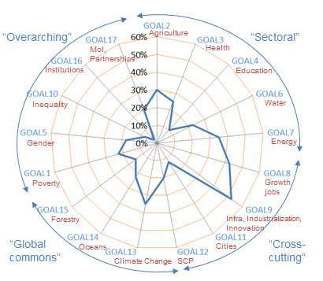
SDG coverage of surveyed STI initiatives (46)
Source: IAWG Survey (2015).

Slide 8
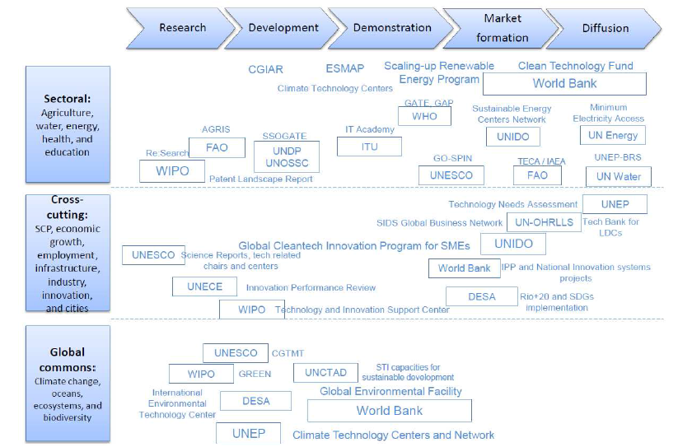
SDG coverage and resources dedicated to surveyed UN system activities on STI

Slide 9
National Stakeholders
Decision Makers Universities, Research, Industry, Economy)
Entrepreneurship
Civic Society
Officials
Working level experts Planners/Managers
National Technology Transfer Office (NTTO)
Investment Platforms
chambers of Industry
Innovation Funding Agencies
Incubators & Science Parks
9

Slide 10
Problem Tree
Deprived and Underutilized Educated Youth in the Arab Region
Noncompetitive production sectors (industry, agriculture and health, others)
Lack of Policies to Promote R&D and Modernization
Broken Cycle between Universities Research and Local Social and Economic Challenges
Absence of Institutional Development and Innovation Awareness and Strategies
Lack of Enabling Environments and Incentives for University - Private Sector Collaboration
10

Slide 11
Objective Tree
Dignifying lives through Decent Employment for Arab Youth at Home
Competitive Productive Economy
Enabling Environment Based on Integrated and Stable Legislations
Steering the Existing capacities in the Local Universities towards Addressing Social, Environmental and Economic challenges
The establishment of NTTO, Related System and Enabling Policies (taxes, export/import, others)
The Universities and Research Centers: TT & IP policies integrated with staff and faculty evaluation and promotion
11

Slide 12
Partners
- Academy Of Scientific Research & Technology (ASRT), Egypt
- Tunisian National Agency for Research Promotion (ANPR), Tunisia
- The Research Council (TRC), Oman
- National Centre for Scientific and Technological Research (CNRST), Morocco
- The National Council for Scientific Research (NCSR), Lebanon
12

Slide 13
Main Activities
1
National workshop to establish a national project working group
2
National studies to determine gaps in relevant government policies
3
Workshop with governmental to prepare NIS roadmap
4
National capacity development workshop with technical leadership
5
Establish NTTO
6
Launching event of NTTO operations
7
Regional forum for existing and newly NTTOs
13

Slide 14
Reports
Name | Task | Outcome
A1.1: Support the National Stakeholders Workshop | Review of the available NIS various components. | National landscape of the present NIS
A1.2: National Study: Relevant Policies for Establishing an Effective System of Strategic Innovation & TT | Set up the basis of relevant structure for establishing the system | Establishing an effective system of strategic innovation and TT in the country.
A1.3: Support Governmental Related Bodies Workshop | National Legislative Gap study for NIS | Draft NIS roadmap
A1.4: Technical Leaders Workshop | Support the National Stakeholders Capacity building | Customized IP & TT policies at institution levels
A2.1: Develop NTTO Operational framework | Operational framework reference for the NTTO unit | Complete operational framework reference
A2.1: Train the NTTO staff on the operational duties | Train the NTTO staff on the operational duties | Training manual
A2.2: Operational Foresight of the NTTO | Operational foresight of the NTTO and scenario case studies | Report for sustainable operation of the NTTO
A2.2: Train the liaison officers on the operational duties | Training topics for the liaison officers | Training manual
14

Slide 15
Events
Name | Target Audience | Outcomes | Related Outputs
A1.1: National Stakeholders Workshop | Ministries, Universities, Research institutions, Technology councils | National project working group | Study A1.1
A1.3: Governmental Related Bodies Workshop | High level policy, Public Institutions, Ministries, Universities, Private Sector | NIS legislation roadmap | Studies A1.2, A1.3
A1.4: National Capacity Development Workshop for Technical Leadership | Research Institutions, Universities, Public Organizations & Private Sector | Key national steps developed in preceding phases of the project | Studies A1.2, A1.4
A2.2: Launching NTTO | Universities, Research Institutions, Industry, Government Institutions | Operations for the future work of the NTTO | Studies A1.1, A1.2, A1.3 A1.4, A2.1, A2.2
A2.3: Regional Forum of National Technology Transfer Offices | Partner Institutions, Universities, Research Institutes, Government Bodies | Regional Forum on the establishment of the NTTO | ALL
15

Slide 16


















Expected Outcomes
National innovation system roadmap in each of 5 countries
National Technology Transfer Office established in each of 5 countries
16

Slide 17
Tentative Work Plan 2015/2016
Activities |  | Timeline 2015 |  |  |  |  |  | Timeline 2016 |  |  |  |  |  |  |  |  |  |  |  | Timeline 2017
 |  | Jul | Aug | Sep | Oct | Nov | Dec | Jan | Feb | Mar | Apr | May | Jun | Jul | Aug | Sep | Oct | Nov | Dec | Jan | Feb | Mar | Apr | May | Jun
A1.1 | Conduct 5 National workshops in Morocco, Tunisia, Egypt, Lebanon and Oman
A1.2 | Prepare 5 national studies, in each target country,
A1.3 | 5 Workshops with governmental related bodies
A1.4 | 5 Workshops for leadership of universities and relevant institutions
A2.1 | Establish NTTO in each targeted country
A2.2 | Launching event of NTTO operations accompanied by the production of a consensus policy development framework strategy
A2.3 | Regional forum for the ESCWA countries
External Evaluation

Slide 18
Thank you

